Slide 1
Digital Portfolio
STUDENT NAME: ANITHA K
REGISTER NO AND NMID: 2422k0468/ A2DDA021E77CF8DBA484679800773BA7
DEPARTMENT: BACHELOR OF COMPUTER SCIENCE
COLLEGE: THAVATHIRU SANTHALINGA ADIGALAR ARTS,SCIENCE AND TAMIL COLLEGE AFFILIATED TO BHARATHIYAR UNIVERSITY

Slide 2
PROJECT TITLE
Personal Portfolio Website:
Website showcasing your skills, experience and projects.
Personal Portfolio Website:
Website showcasing your skills, experience and projects.

Slide 3


AGENDA
Problem Statement
Project Overview
End Users
Tools and Technologies
Portfolio design and Layout
Features and Functionality
Results and Screenshots
Conclusion
Github Link
3/21/2024 Annual Review

Slide 4

PROBLEM STATEMENT
This digital portfolio aimsto effectively showcaseskills, experience, andprojects, while alsoproviding a great userexperience for visitors.

Slide 5

PROJECT OVERVIEW
1. About Section: Brief introduction to background skills and experience.
2. Project Showcase: Curated selection of best work,with descriptions, images and links to live projects or code repositories.
3. Skills and Expertise: List of technical skills and areas of expertise.
4. Contact Information: Contact form or emailaddress for potential employers, clients or collaborators.

Slide 6

WHO ARE THE END USERS?
Potential employers: Hiring managers,recruiters, and other stakeholders in the webdevelopment/design industry.
Clients: Businesses or individuals looking forweb development/design services.
Collaborators: Other developers, designers, orprofessionals interested in potentialcollaborations.

Slide 7

TOOLS AND TECHNIQUES
HTML
CSS
JAVASCRIPT
CODE PEN AS CODE EDITOR
GITHUB AS HOSTING PLATFORM

Slide 8
POTFOLIO DESIGN AND LAYOUT
Clean and Simple Design:
Use a minimalist approach to showcase your work without distractions.
Consistent Typography:
Choosea clear, readable font and use it consistently throughout the portfolio.
Color Scheme:
Select a palette that reflects your personal brand and use it consistently.
White Space:
Use ample white space to make your content stand out and improve readability.
Imagery:
Use high-quality images and graphics to showcase your work.
Responsive Design:
Ensure that your portfolio looks great on desktop, tablet, and mobile devices.
Navigation:
Use a simple, intuitive navigation menu that makes it easy for visitors to find what they're looking for.
LAYOUTS
1. Grid-based layout:A clean and simple layout that showcases projects in a grid format.
2. Masonry layout: A layout that showcases projects in a grid format with varying heights and widths.
3. Single-page layout: A layout that showcases all content on a single page, withsections and scrolling.
4. Multi-page layout:A layout that separates content into multiplepages, with navigation between sections.
8

Slide 9
FEATURES AND FUNCTIONALITY
Features:
1. Project showcase: A curated selection of projects with images, descriptions,and links.
2. About page: A brief bio and introduction to background, skills, andexperience.
3. Contact form: A form for visitors to send messages or inquiries.
4. Social media integration: Links to social media profiles.
5. Responsive design: Adapts to different screen sizes and devices.
Functionality:
1. Easy navigation: Simple and intuitive menu for easy content access.
2. Fast loading times: Optimized for quick loading on various devices.
3.Interactive elements: Animations, transitions, or other interactive features.
4. Search engine optimization (SEO): Optimized for search engine visibility.
5. Regular updates: Easy to update with new projects, skills, and experiences.

Slide 10
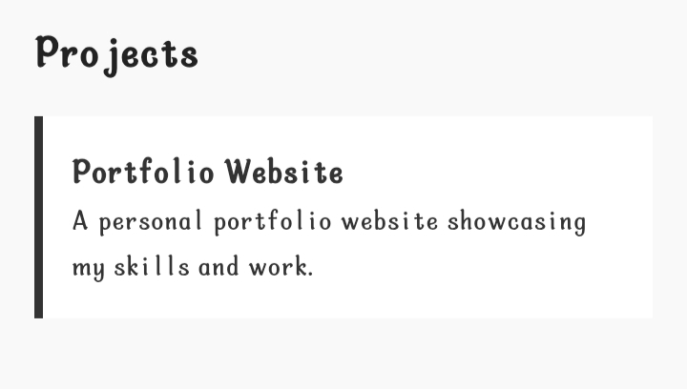
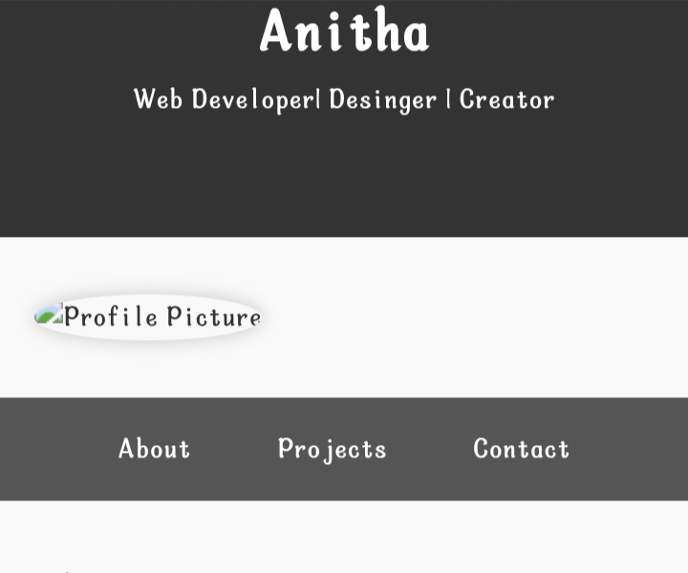
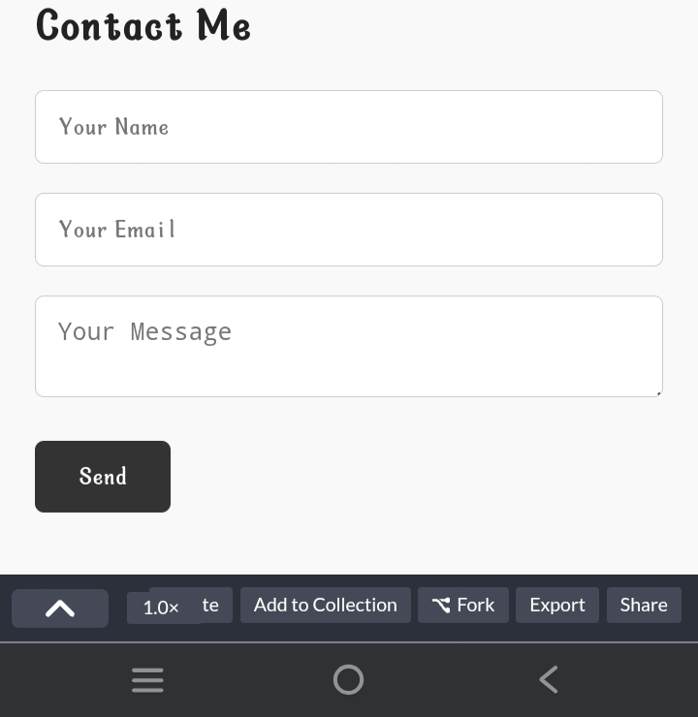

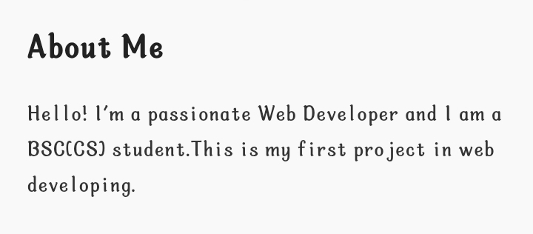
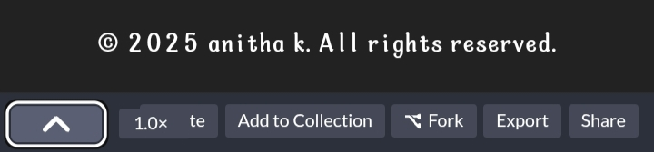
RESULTS AND SCREENSHOTS
3/21/2024 Annual Review
10

Slide 11
CONCLUSION
"Thank you for exploring my portfolio! I'm excited to collaborate, innovative and bring new ideas to life. Feel free to reach out to discuss potential projects or opportunities. Let's create something amazing together!"
11

